Slide 1
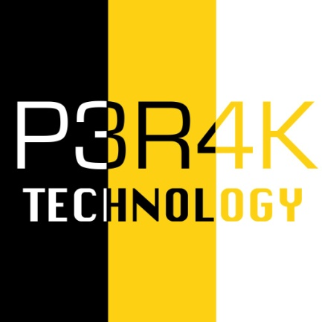

Perak Technology Session Blockchain - Distributed Database
27 April 2019
Pusat Internet Kuala Kangsar

Slide 2
Perak Technology
Perak ICT Community by Elania Resources
Gather all ICT and technology expert from all over Perak.
Bring all ICT and technology event and program back to Perak State.
Boost ICT and technology industries in Perak.
Expose new technology and ICT services to Perak citizen.
Link: https://peraktechnology.com

Slide 3
SCOPE
History Of Blockchain
Blockchain Definition
Type Of Blockchain
Blockchain Network
Blockchain Security
Consensus Ledger
Blockchain Programming

Slide 4
The Bitcoin
Bitcoin was the first major blockchain innovation.
A digital currency experiment.
Used by millions of people for payments.
Bitcoin: A Peer-to-Peer Electronic Cash System paper was posted to a cryptography mailing list on 31 October 2008 by Satoshi Nakamoto.
Bitcoin code was released on January 2009

Slide 5
The Blockchain
Blockchain is the underlying technology that operated bitcoin.
It could be separated from the currency and used for all kinds of other interorganizational cooperation.
Almost every major financial institution in the world is doing blockchain research at the moment.

Slide 6
Smart Contract
Ethereum is a little computer programs built directly into blockchain that allowed financial instruments.
It allow loans or bonds, to be represented, rather than only the cash-like tokens of the bitcoin.

Slide 7
Definition
Digital information (the “block”) stored in a public database (the “chain”).
Blocks store information about the transactions, who is participating and what distinguishes them from other blocks.
Managed by cluster of computers not owned by any single entity.
Each of these blocks of data (i.e. block) are secured and bound to each other using cryptographic principles (i.e. chain).

Slide 8
Type of Blockchain
Public Blockchain
Private Blockchain
Federated Blockchain

Slide 9
Public Blockchain
Anyone can participate in reading, writing, or auditing the blockchain.
Open and transparent.
Decision making happens by various decentralized consensus mechanisms

Slide 10
Private Blockchain
Read and write access managed by a centralized entity within organization.
Groups and participants who can verify transactions internally.
Some would argue that such a system cannot be defined as a blockchain.

Slide 11
Federated Blockchain
Consensus process is controlled by a pre-selected set of nodes.
Faster (higher scalability) and provide more transaction privacy.
Some would argue that such a system cannot be defined as a blockchain.

Slide 12
Blockchain Network
Nodes
Miner

Slide 13
Nodes
Form the infrastructure of a blockchain
Connected to each other and they constantly exchange the latest blockchain data with each other so all nodes stay up to date
Nodes can be any kind of device such as computers, laptops or even bigger servers.

Slide 14
Miner
Miners validate new transactions and record them on the blockchain.
Miners compete to solve a difficult mathematical problem based on a cryptographic hash algorithm

Slide 15
Blockchain Security
Digital keys (Public key and Private key)
Digital signatures

Slide 16
Public Key
Mathematical functions that constitute public key cryptography
Easy to calculate in one direction
Practically impossible to calculate in the opposite direction
Facilitates the creation of unforgetable digital signatures for ownership on decentralized networks.

Slide 17
Private Key
Alphanumerical characters that give a user access and control over their funds to their corresponding cryptocurrency address.
Sign transactions that allow the user to spend their funds.
Proving that the user does in fact have ownership of those funds.

Slide 18
Digital Signatures
Mathematical scheme that is used for showing the authenticity of a digital message or document.
Message or document was in fact created by a known sender.
Indicates that the sender can’t deny having sent the message or document.
The message or document was not altered at any point while it was in transit.

Slide 19
Consensus Ledger
Data is stored across a network of computers called nodes.
Nodes on the network verify the transactions, and agree with their order and existence on the ledger.
Removes the necessity of a single organization controlling the data.
Different consensus mechanisms devised to make this trustless system work.

Slide 20
Blockchain Programming
Repository:
https://github.com/peraktechnology/blockchain
Open Command Prompt
Type: python blockchain.py
Browse: http://localhost:5000
Mine: http://localhost:5000/mine
Register Nodes: http://localhost:5000/nodes/register

